Slide 1


PROJECT TITLE : HOTEL RATING CLASSIFICATION
TEAM MENTOR : MR. PARTH
PROJECT NAME AND NUMBER : TEAM 3 (P64)

Slide 2
BUSINESS OBJECTIVE
PROBLEM STATEMENT :
Extract reviews from trip advisor and the ratings for different hotels and our goal is to examine how travelers are communicating their positive and negative experiences in online platforms for staying in specific hotel and major objective is what are attributes that travelers are considering while selecting a hotel with this manager can understand which elements of their hotel influence more in forming a positive review or improve hotel brand image.

Slide 3
DATA COLLECTION
EDA
MODEL BUILDING
EVALUATION
DEPLOYMENT
PROBLEM STATEMENT
DATA PRE-PROCESSING
FINALIZING THE MODEL
PROJECT PROCESS FLOW

Slide 4

DATA COLLECTING BY USING WEB SCRAPPING :
Web scrapping ,web harvesting, or web data extraction is data scraping used for extraction data from websites. The web scraping software may directly access the world wide using the hypertext transfer protocol or a web browser.
While web scraping can be done manually by a software user, the term typically refers to automated process implemented using a bot or web crawler.

Slide 5
TOOLS FOR WEB SCRAPPING
Selenium
Import.io
Phantom.js
Scrapy
BeautifulSoup
Etc.
Note – We have used BeautifulSoup for web scrapping for our project.

Slide 6
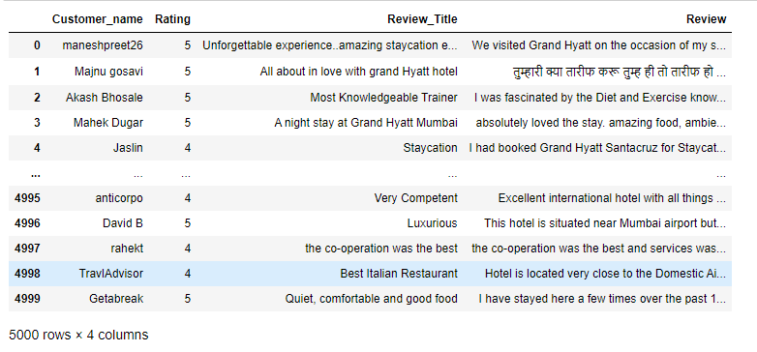
DATAFRAME

Slide 7
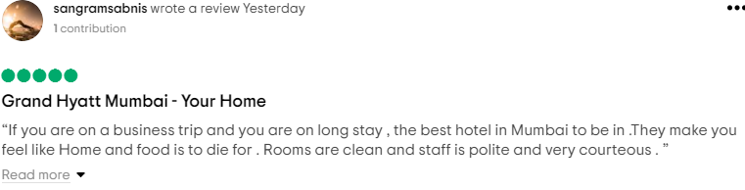





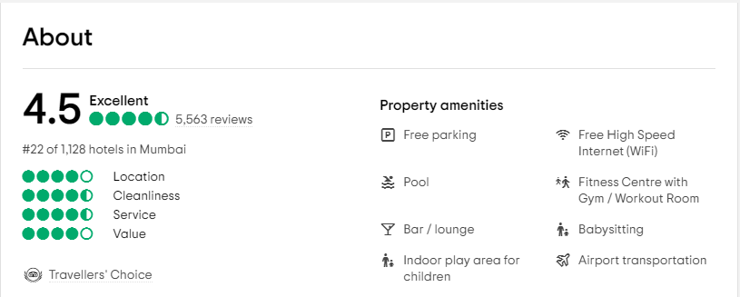

Slide 8
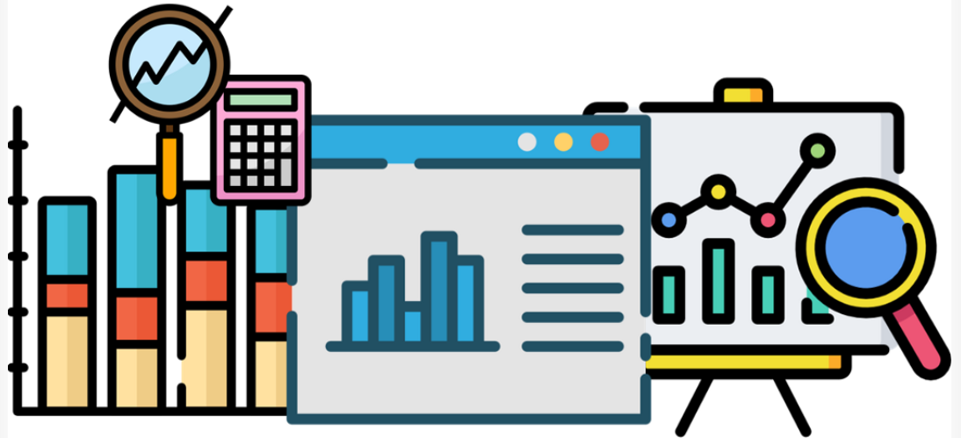
EXPLORATORY DATA ANALYSIS (EDA)
EDA refers to the critical process of performing initial investigations on data so as to discover patterns, to spot anomalies, to test hypothesis and to check assumptions with the help of summary statistics and graphical representations.
DESCRIPTIVE STATISTICS :
Descriptive Statistics process describes the basic features of data in a study. It delivers summaries on the sample and the measures and does not use the data to learn about the population it represents.
TEXT DATA CLEANING :
Data Cleaning means the process of identifying the incorrect, incomplete, inaccurate, irrelevant or missing part of the data and then modifying, replacing or deleting them according to the necessity.

Slide 9
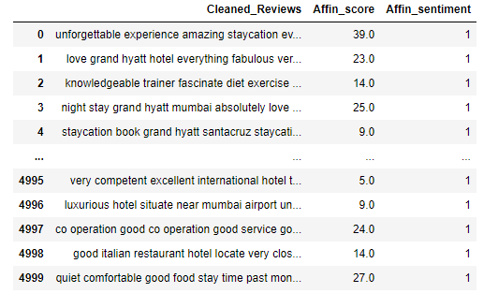
SENTIMENTAL ANALYSIS USING AFINN :
Afinn is a popular lexicons used for sentiment analysis developed by Finn Årup Nielsen.
It contains 3300+ words with a polarity score associated with each word.

Slide 10
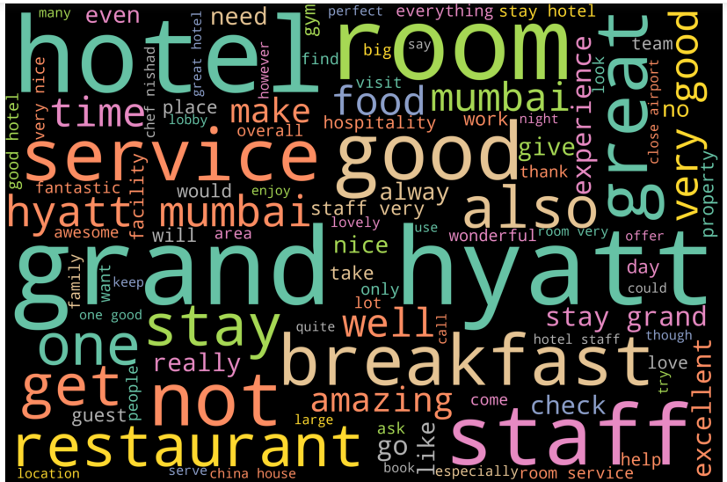
WORD CLOUD :
Word cloud is a technique for visualizing frequent words in a text where the size of the words represents their frequency.

Slide 11
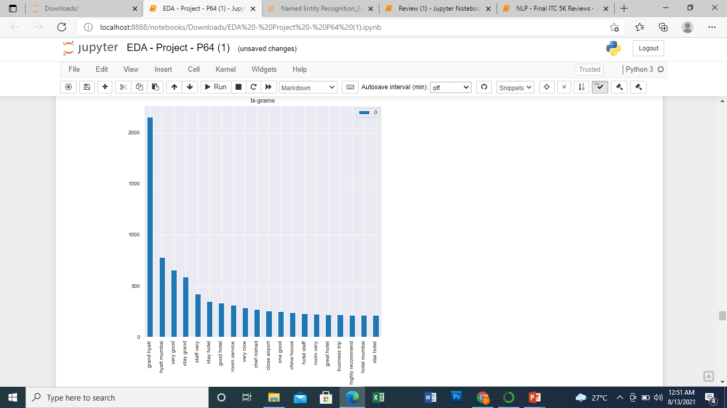
TERM FREQUENCY WITH
COUNT VECTORIZER
Bar graph for frequent bi-grams

Slide 12
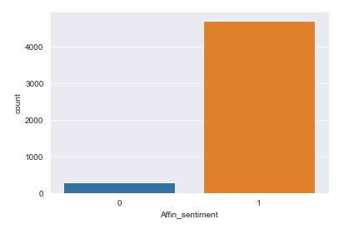
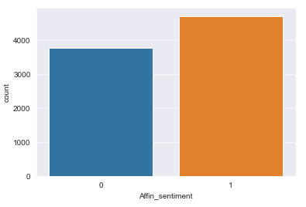
HANDLING IMBALANCE DATA SET USING SMOTE :
Imbalanced datasets are a special case for classification problem where the class distribution is not uniform among the classes. Typically, they are composed by two classes: The majority class and the minority class.
In SMOTE (Synthetic Minority Oversampling Technique) we synthesize elements for the minority class, in the vicinity of already existing elements.
SMOTE

Slide 13
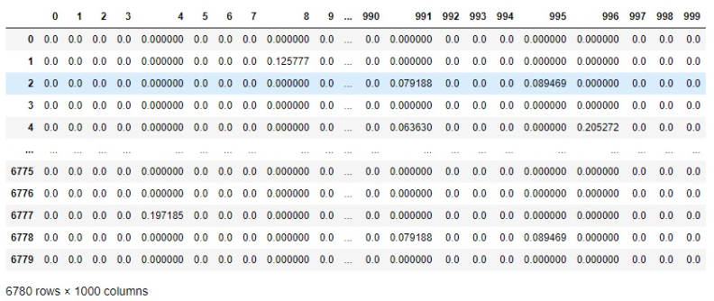
SPLIT INTO TRAIN AND TEST :
The train-test split procedure is used to estimate the performance of machine learning algorithms when they are used to make predictions on data not used to train the model.
TF-IDF :
Transforms text to feature vectors that can be used as input to estimator.

Slide 14
PCA AND T-SNE :
PCA it is a mathematical technique, but t-SNE is a probabilistic one. Linear dimensionality reduction algorithms, like PCA, concentrate on placing dissimilar data points far apart in a lower dimension representation.

Slide 15
Thank you

